Slide 1
The Online Student enrollment system
ABC University

Slide 2
ABC University
Introduction
Online Student Enrolment System been proposed that will be useful to enhance automation of work processes within the university. Currently, all processes pertaining to student enrolment, tuition fee payment, time table, course registration, etc. It manages the enrolment of the students who wants to register for a online various class.

Slide 3
Key Stakeholders And Actor
ABC University have their several stakeholder who have a specific role in this system.
Some stakeholders of online enrollment system are
Students
Student enrolment officer
Program directors
Vice Chancellor
Pro vice chancellor
Administration

Slide 4
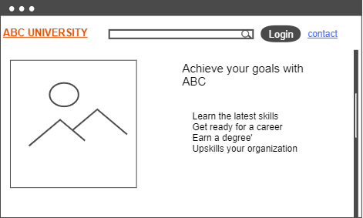
Modules of Enrolment system
Home Page Module:
In this type of module user will able to visit the introduction of the application and where he find the registration process to enroll any course of them . And also can find their required courses with the help of the search box given.

Slide 5
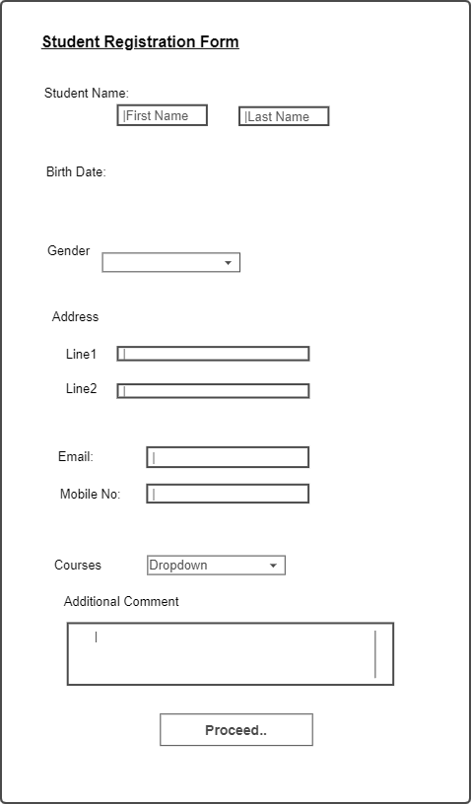
Modules of Enrolment system
Registration Module:
In registration module new user have to register first by fill the registration/enrollment form. In which include the course also which user want to watch or to enroll according to his preference . After filling the required field in the form user will have to proceed the process .

Slide 6
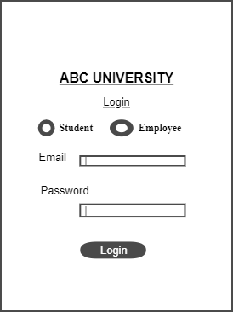
Modules of Enrolment system
Login Module:
In this module a user or student
Would be able to access the system with the help of login email id and the password. If he successfully logged In then he will directly land on the Home page of the enrolment system.

Slide 7
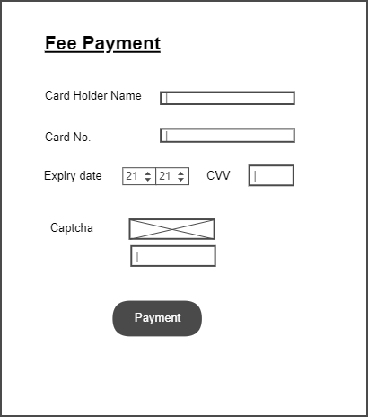
Modules of Enrolment system
Fee Payment Module:
In this module application provides a functionality to users/student pay the fee via online options. And also this module aware the user about their fee pending and remind them to pay on time.

Slide 8
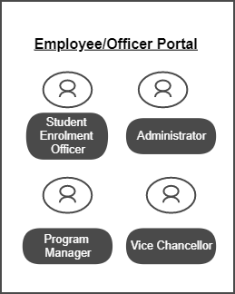
Modules of Enrolment system
Employee Module:
In this module there are different type of employee who can update delete and change any information in respect to time scheduling , classes updating, or for any regarding any queries. Officers and employee have their own roles and responsibilities to maintain the application system also handle the students queries.

Slide 9
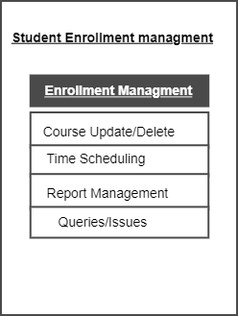
Modules of Enrolment system
Student Enrolment Management:
In this module of enrolment system a employee will handle the process regarding student their enrolment, their courses, their time scheduling and their report creation . Employee/ officer will handle all of the queries related to the student.

Slide 10
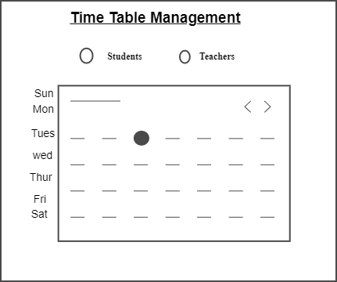
Modules of Enrolment system
Time Tabling Management :
In this management time table officer manages the time table of the given courses and subject with respect to teachers and student feasibility. Also manage the time and course appropriately.Time tabling officer will also be able to use the proposed system for timely identification of clashes and ensuring that relevant timetables are developed in non-redundant format.

Slide 11
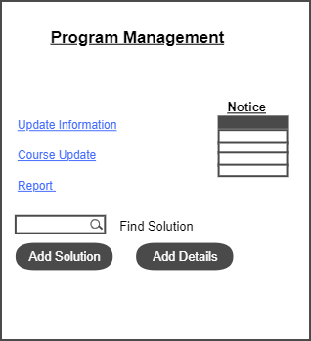
Modules of Enrolment system
Program Management:
In this module Program officer required to generate report and provide solutions to the students and acknowledge them regarding the updated details. Also provide the information about the courses to the users.

Slide 12
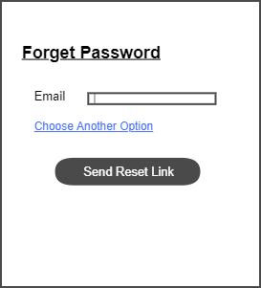
Forget Password
In this setting if user forgets the password then he can retrieve it with the help of forget password setting.
We have to click on the forget password and then we have a page on which we have to give a reference on which we can send password resetting information according to your preference and given criterion.

Slide 13
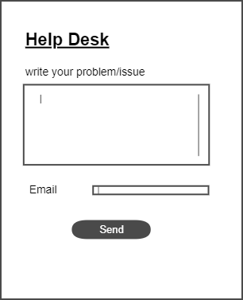
Help Portal
In this portal user/ student can take help for their different issues and facing any technical, educational, regarding payment etc. by this user any user can write their problems and issues and then write email id to provide solution to the user .you can also contact with the employers also.

Slide 14
Conclusion
This report has essentially centered around spreading inside and out data about various parts of the Online Student Enrolment System which has been deliberately proposed by ABC University. In this report, significant partners and entertainers that are related to OSES have been completely talked about. Further, inside and out depiction has been given with respect to major utilitarian and non-useful prerequisites that must be available in the last form of the proposed frameworks. . Hence, this report has covered a wide exhibit of viewpoints relating to the proposed framework.

Slide 15
Reference
Walker, D., Bourne, L., & Shelley, A. (2008). Influence, stakeholder mapping and visualization. Construction Management And Economics, 26(6), 645-658. doi: 10.1080/01446190701882390
Kumar, R., & Krishnan, V. (2017). Reliability Availability and Maintainability Analysis of the Systems. Journal Of Mathematics And Informatics, 11, 131-141. doi: 10.22457/jmi.v11a17
Smith, A., Johnson, A., & Nakamura, M. (2017). Designing and managing a fully online university pre-enrolment course in Japan.

